Slide 1
Skills for Life
The Second Half of the Rapid Eye Model

Slide 3
The Principle of Thought
As we think, so we are!

Slide 4
All thought is creative…
We are creating our world at this very instant.
It is precisely as we think it is, and the moment we take responsibility for our world will be the moment we take control of our world

Slide 5
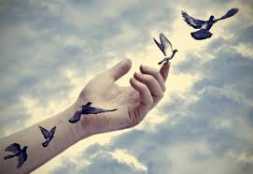
We can ‘image-in’ anything we choose
What we fear today, we live tomorrow.
What we are grateful for today, we live tomorrow.
‘

Slide 6
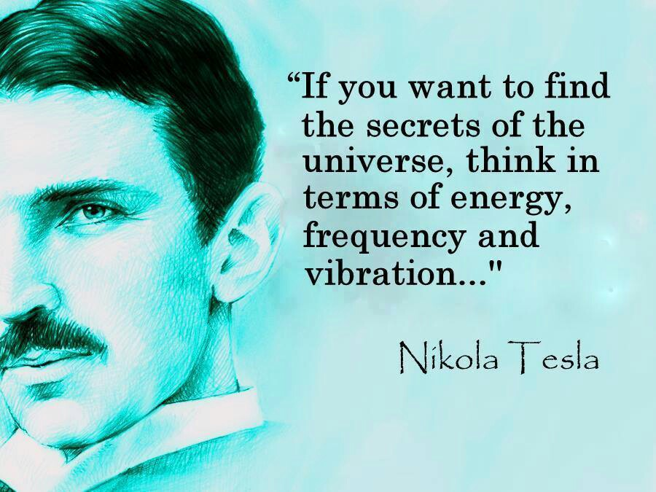

Slide 7
Energy vibrates at varying levels of intensity and frequency, descending from highest to lowest in this order.

Slide 8
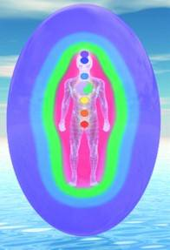
Spiritually, vibrations are the highest, and all things are perfect, whether we remember or perceive it thus, or not
Mentally, we must reduce the frequency of the vibration of that perfection, to form an opinion of it. Our thoughts follow our memory, beliefs, fears, hopes, expectations, etc.
Emotionally, the vibration slows still further, to give us a feeling of it.
These feelings may be based on our perception from previous experience or fear.
Physically, the vibration is the slowest, densest, and the point at which we can tangibly experience that reality – touch it, taste it, see it, know it in the body.

Slide 9
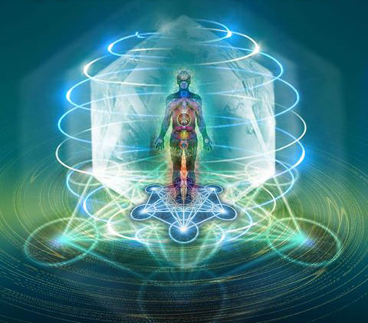
We are electro-magnetic beings

Slide 10
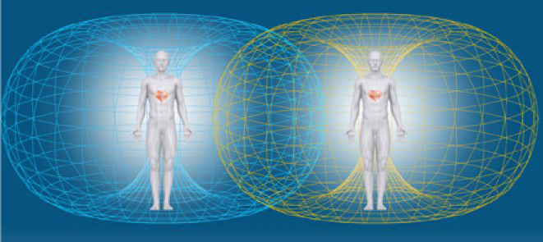

Slide 11
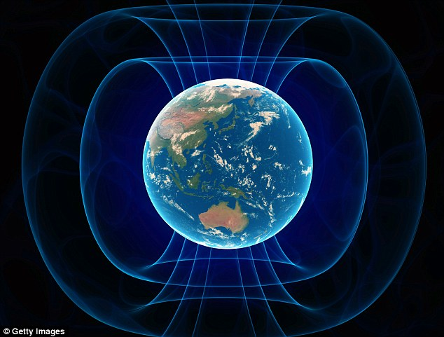

Slide 13
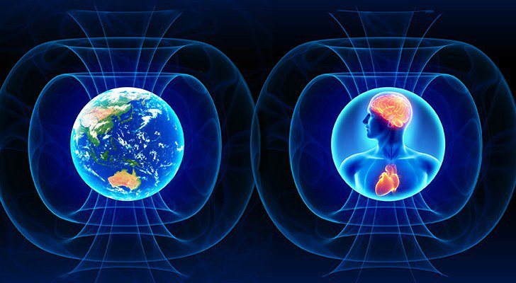

Slide 15
Whatever you really, really, really want will come to you very quickly.
Whatever you really, really, really don’t want will come to you very quickly.
Esther Hicks

Slide 16
Determine the ESSENCE of
what it is that you really, really, really WANT in your life.
What are the essential ingredients of that desire?

Slide 17
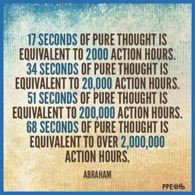

Slide 18
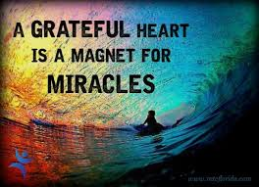

Slide 19
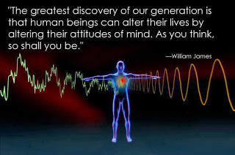

Slide 20
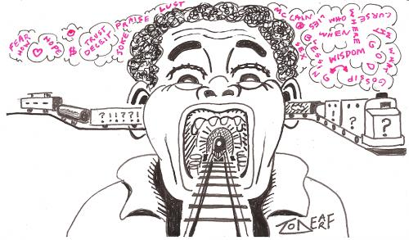
Have you ever found yourself on a “runaway train of thought”?

Slide 21
You cannot STOP doing anything
You must START doing something ELSE

Slide 22
Ask yourself….
Is THAT what I really, really, really want?
And the answer is..
NO! I AM…

Slide 23
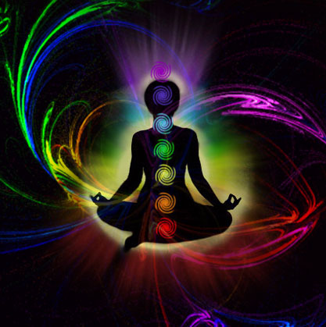
Balanced!
Awake!
Creative!
Fun!
Effective
Determined!

Slide 24
What, Why, How
Alphamations?

Slide 25
About Choosing:
This is a process designed to occupy and exercise your mind INSTEAD of worrying. The process should take you some time, and not be rushed or written down. The POINT is to memorize and hone your list

Slide 26
NEGATIVE words that come up are as valuable as positive ones. Explore those words for veracity and love them to death.
Remember that the first step to healing self-defeating beliefs is to HONOR them. You can only heal what you are conscious of.

Slide 27
Ken Carey describes negative emotions as “ill spirits” that reside within us and arise as bubbles. A bubble is a void contained within a thin surface-tension coating. Ken suggests that the void is really LOVE, within and without! (as love is all there is)

Slide 28
Ken further describes the surface tension coating as the ILL SPIRIT or emotion – delicate and temporary –- and that as these bubbles arise we have three options:
1: DENY the emotion – stuff it back down – and strengthen it for next time it arises
2: EXPRESS the emotion in all it’s ferocity – TELL that TERRIBLE PERSON how you REALLY FEEL about it….and strengthen the emotion for next time it arises….
Notes:
Because of bubbles, this slide needs two extra clicks to progress to the next slide

Slide 29
OR, we can EMBRACE the emotion – give it what it only ever wants – which is to be one in love,

Slide 30
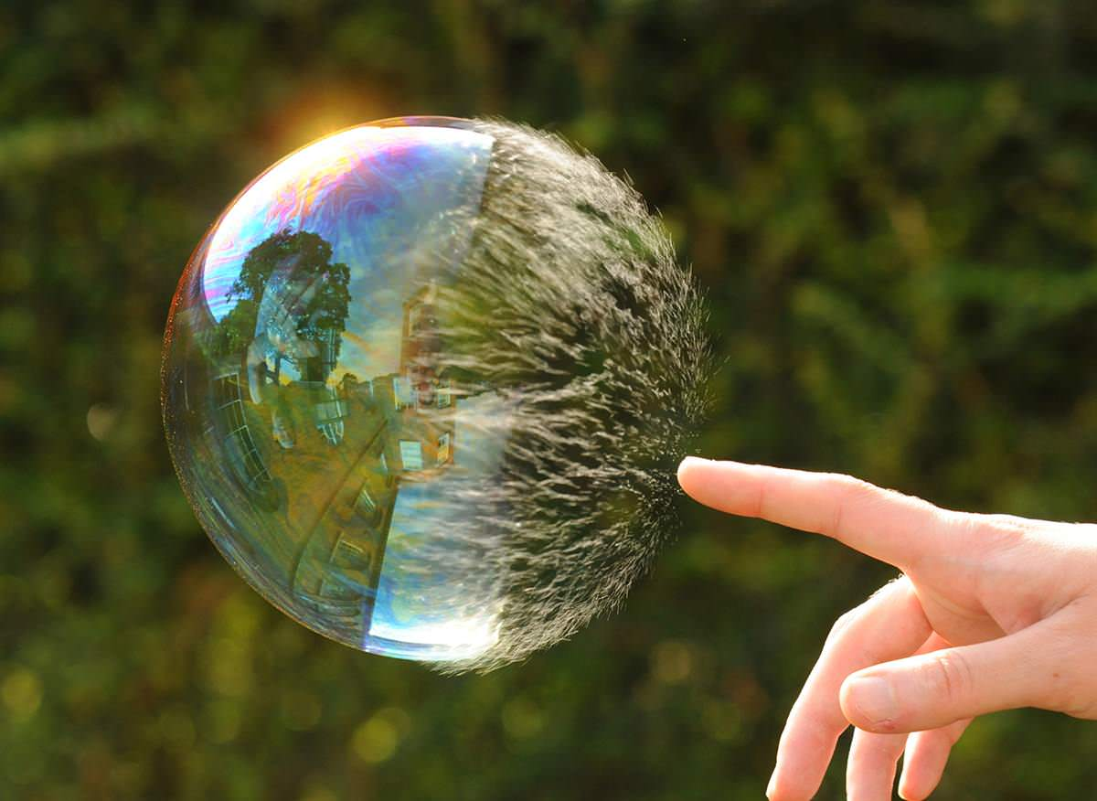
and the emotion will be healed – returned to
the only reality – which is of course -- all prevailing LOVE….

Slide 31
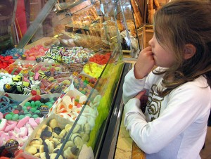
CHOOSING and MEMORIZING the words is an important mental callisthenic designed to change the direction of your train of thought…
Think of the dictionary as a wondrous store of words describing your soul’s desires and purposes

Slide 32
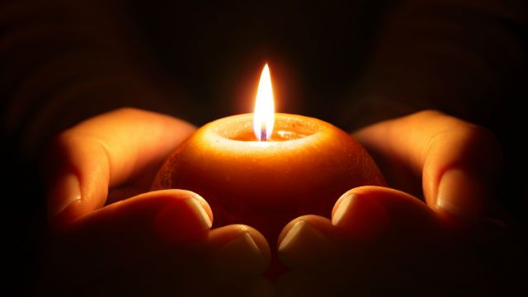
Allow the words to wax on, nurturing, savoring, memorizing them until they become a part of your every waking moment
And when you answer the call of nature in the night, the words are running as you arise

Slide 33
Remember that words are vibrations of the thought or principle that you espouse, and if YOU are even cognizant of that word, it is YOUR vibratory signature.
In other words, ‘as a man thinketh, so IS he.” You cannot think what you are not.
Therefore, if you ‘vibe’ with a word -- that word
describes your I AM Being.

Slide 34
Life is WAITING to embrace you with all-encompassing LOVE
Meet it halfway and BE the Love!

Slide 35
Keep your eye on the light,
and the obstacles
will fall away, each one revealing itself as the stepping stone to your own best and highest purpose

Slide 36
Three Principles of Manifestation
The Principle of Creative Thought – What we believe is what we create
The Principle of Mental Clearing – We must clear our self-limiting beliefs before we can manifest new beliefs

Slide 37
The Principle of Vision – In order to manifest, we must have a clear vision of what we want to create

Slide 38
School Your Thoughts!
The first step to school your thoughts
is to watch your language
–both silent and otherwise
LISTEN to your inner thoughts and correct them when they are off track.
LISTEN to what you say to others and hold yourself accountable for your words

Slide 39
Say, I FEEL tired rather than I AM tired
I CHOOSE… rather than I DECIDED
Ask Yourself -- What is his/her/your ABILITY to RESPOND? Who’s RESPONSE-ABILITY is it?
Going on a DIET? Why not a LIVE-IT?
Don’t SHOULD on yourself or others. What are you asking them to shoulder? Who says what “should be”?
Choose to “LIVE for!” your favorite things rather than…

Slide 40
Find ways that work for you to make a serious study of your own beliefs and perceptions that are steering you in paths you choose to change.
Journal
Find a Compassionate Witness
Try Peer Counseling
Seek out a Trusted advisor
Rapid Eye Technology

Slide 41
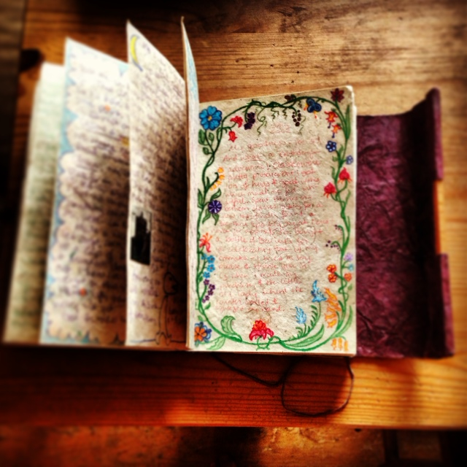
JOURNAL
All your answers lie within –- mine them!
Journals can save your LIFE! Writing can capture thoughts you didn’t know you had, and channel deep inner wisdom otherwise untapped. Spiritual Memory Is fleeting –Journals can preserve and protect precious insights and shed Light in the darkness

Slide 42
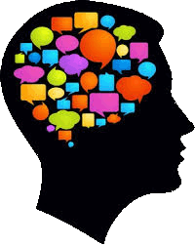
Inner Self Dialogue
We ALL have inner children, guides, guardians, judges, critics, and even ‘villains’ who rule our lives without our conscious awareness. Gaining access
to these inner ‘beings’ (states of being) and creating co-operation among them can go a very long way in allowing cohesion and integration within our lives – being able to live in integrity with our ideals without interference from inner conflicting subconscious characters in our makeup who mean well but who are operating without full awareness of the ‘facts’, of current ‘reality’, or of our best and highest good

Slide 43
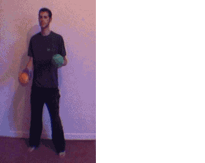
We each operate from two sides of the brain, which have very different roles:
Left brain – conscious, logical, bottom-line thinking which keeps us sane and operating on a day-to-day basis of logic and reason – roughly 10% of our brain power at our conscious disposal --
Right-brain sees the whole picture from beginning to end, operates in positive/spiritual mode, home to imagination, memory, artistic abilities, and in short, is the 90% of our brain which “uses us” according to our subconscious and superconscious filing systems, belief systems, perceptions, anccestral programs, etc.

Slide 44
Both sides of these stories can be accessed by a simple technique of writing which allows both hemispheres of the brain to participate in ongoing dialogue. Simply switch the pen from one hand to the other, designating your dominant hand as the one asking the questions, and your opposite hand as the one who answers.

Slide 45
If there are more than one voice speaking from the subconscious mind, one can simply change colors of ink to accommodate each participant.
It is possible to have a full array of inner voices attending a meeting conducted within the pages of your journal.

Slide 46
THOUGHTS are ENERGY
Thoughts FUEL Emotions
Emotions are thoughts (energy) in motion
Emotions manifest as your reality
A runaway train of thoughts will drag your emotions along
EMOTIONS create your reality as they attract or repel those things you think about.
That is, if your thoughts are full of gratitude, you will attract more of what you are grateful for
If your thoughts are fearful, depressed, negative, jealous, resentful, etc., you will attract more of what brings you such feelings

Slide 47
FEELINGS buried alive NEVER DIE
While You cannot ‘think’ your feelings away, pretending they don’t exist, or denying their impact, -- clearing out your thinking processes, addressing the issues, thoughts, beliefs, memories, misperceptions, family legends, etc, that direct your thoughts --can be a way to reboot and re-write your reality

Slide 48
