Slide 1
Skills for Life
The Second Half of the Rapid Eye Model

Slide 2
This presentation created by Julia Fairchild with loving Aloha

Slide 3
The Principle of Cause and Effect
Cast your bread upon the water and it will come back buttered!

Slide 4
We are the Cause and We are the Effect
We are creating our world at this very instant.
It is precisely as we THINK it is, and the moment we take responsibility for our reality, will be the moment we take control of our world

Slide 5
To ‘respond ably’ we must be able to take stock of what choices we have made that bring us to the place we want to turn around

Slide 6
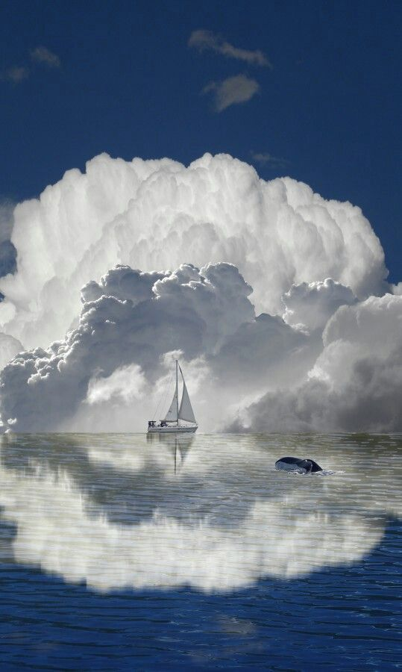
If you are alive –
If you are in this class –
There are things you wish you could have done or could now do differently
No one ACCIDENTALLY lives a life of absolute peace, joy, love, health, wealth, and wisdom.

Slide 7
THE GOLDEN RULE

Slide 8
We know this Law by many names:
What goes around comes around
You reap what you sow
The Law of the Harvest
Karma
The Law of Cause and Effect

Slide 9
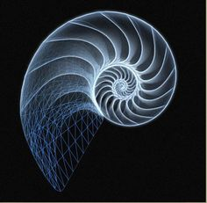
The cycle of every creation begins with a
THOUGHT
Which then passes through the realms of
Mental
Emotional, and
Physical development

Slide 10
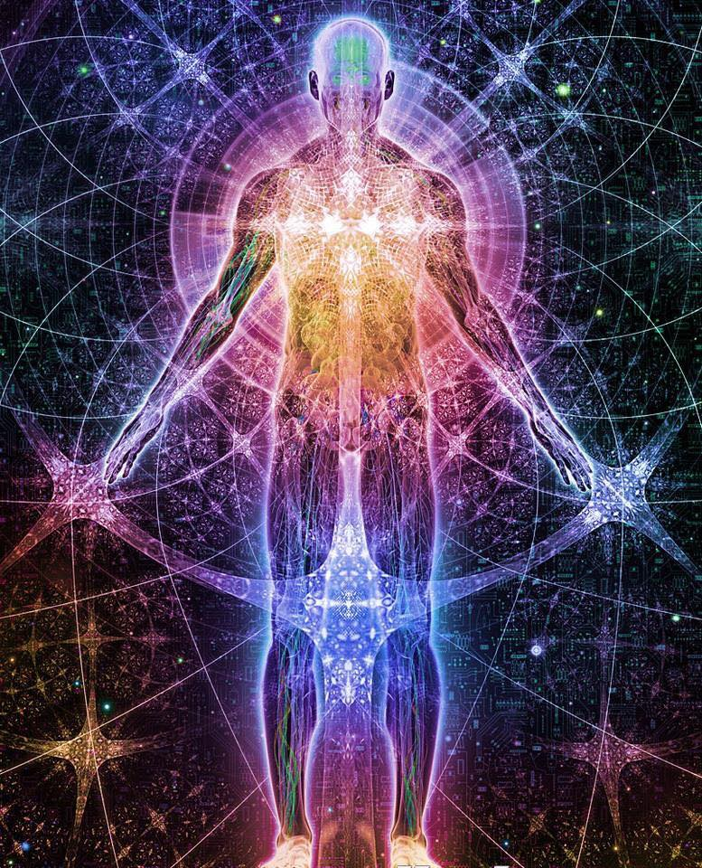
The spirit body contains the power to create our existence, and all things we perceive therein

Slide 11
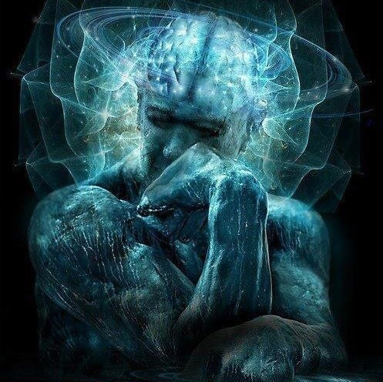
The spirit body is the source of all power and creative force –
Indeed
the Life Force
we experience in this dimension

Slide 12
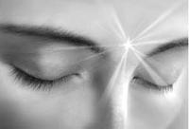
The mental body is the directive body
The job of the mental facility
is to make choices

Slide 13
The mental body is the home of our ego, and thus has the ability to see (re-cognize) itself as the source of power, or the creative force.
While the fearless spirit body can enjoy ALL experience, the mental body seeks to keep us physically and emotionally comfortable, and to protect us from potential harm.
The mental body ultimately directs energy

Slide 14
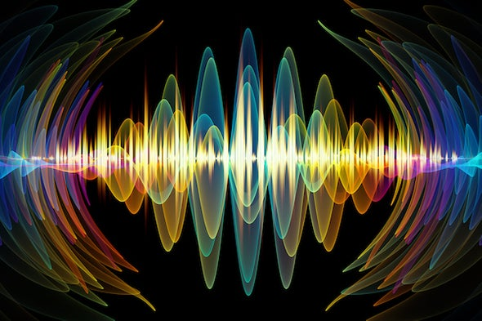
The emotional body focuses
our directed energy
into physical dimensions

Slide 15
Our feeling about our choice will largely determine the form in which it will manifest

Slide 16
One way to direct our feelings
to more peaceful outcomes
is to clean out our ‘memory files’ of past experiences which may influence our current perceptions, thoughts and feelings.

Slide 17
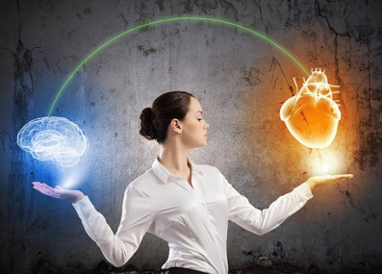
Our physical bodies are only obedient to our mental and emotional bodies (thoughts/feelings).
Awareness of our selves as having spiritual, mental, and emotional bodies which ultimately mold the physical body and its circumstances and environment is key to directing our own desirable outcomes.

Slide 18
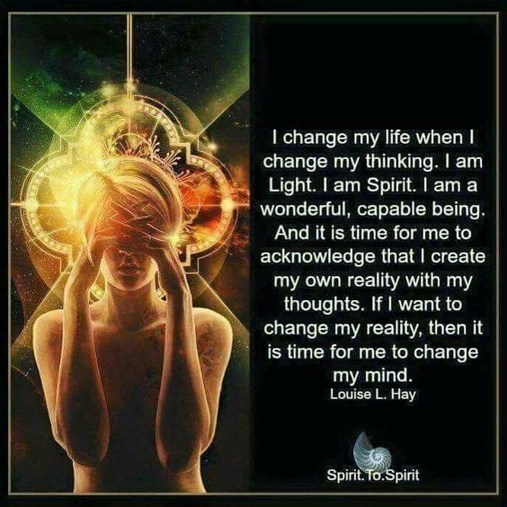
OR, we can EMBRACE the emotion – give it what it only ever wants – which is to be one in love,

Slide 19
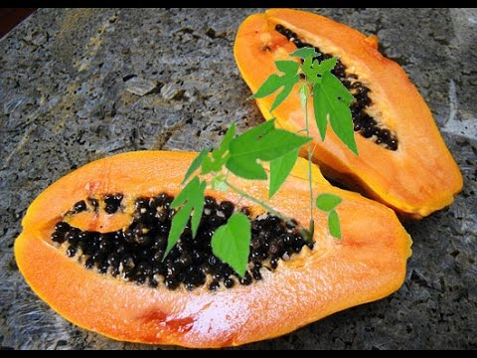
The energy we direct and feel will by design come back to us multiplied

Slide 20
Experience is not what happens to a man.
It is what a man does with what happens to him. Aldous Huxley

Slide 21
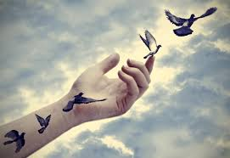
Learning to see ourselves from the perspective of being at choice, and therefore at cause. . .
Rather than from the perspective of being the victim of circumstance ~
Is a first step toward personal empowerment
and freedom

Slide 22
Cause and Effect
can be re-cognized
as a cycle of creation
Your first clue to a cycle of creation is an oft-recurring pattern in your life.
When events repeat themselves, look for the lesson.

Slide 23
After the initiating thought, the first manifestation of a cycle of creation is
speech.

Slide 24
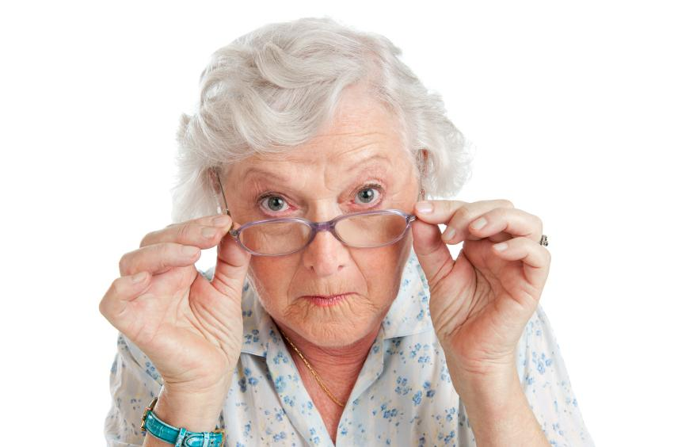
So a good place to begin is to learn to watch your
language!

Slide 25
Developing an ear for self-defeating language can be a useful skill.
For example, ‘but’ negates every word that precedes it, i.e.
“I love you, but we don’t hit people.”
Which says: “I love you, until you hit someone, and then you’re not so lovable anymore.”

Slide 26
Try instead,
“I love you, and we don’t hit people.”
Which says:
“I love you, and in my love for you, I want you to learn how to be loving and lovable.”

Slide 27
School Your Thoughts!
The first step to school your thoughts
is to watch your language –both silent and otherwise
LISTEN to your inner thoughts, and correct them when they are off track.
LISTEN to what you say to others and hold yourself accountable for your words

Slide 28
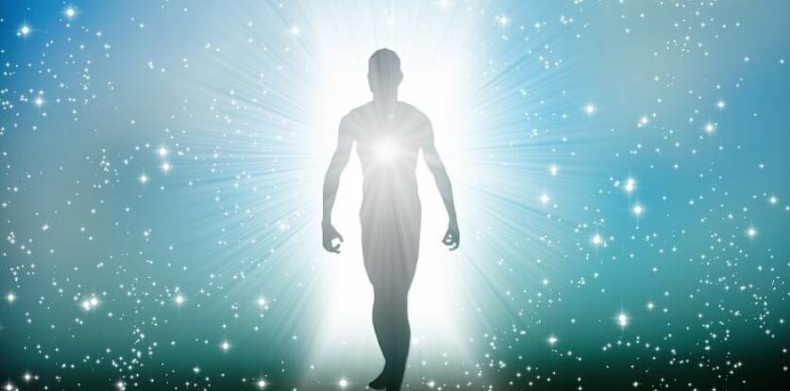
THOUGHTS are ENERGY which FUEL Emotions
Emotions are thoughts (energy) in motion
Emotions manifest as your reality
A runaway train of thoughts
will drag your emotions along
EMOTIONS create your reality as they attract or repel those things you think about.
Gratitude attracts more of what you are grateful for
Fearful, depressed, negative, jealous, resentful, feelings attract more of what brings you that.

Slide 29
Say, I FEEL tired rather than I AM tired
I CHOOSE… rather than I DECIDED
Ask Yourself -- What is his/her/your ABILITY to RESPOND? Who’s RESPONSE-ABILITY is it?
Going on a DIET? Why not a LIVE-IT?
Don’t SHOULD on yourself or others. What are you asking them to shoulder? Who says what “should be”?
Choose to “LIVE for!” your favorite things rather than…

Slide 30
Find ways that work for you to make a serious study of your own patterns and perceptions that are steering you in paths you choose to change.
Journal
Find a Compassionate Witness
Try Peer Counseling
Seek out a Trusted Advisor
Rapid Eye Technology

Slide 31
FEELINGS Buried Alive NEVER DIE
While You cannot ‘think’ your feelings away, pretending they don’t exist, or denying their impact, -- clearing out your thinking processes, addressing the issues, thoughts, beliefs, memories, misperceptions, family legends, etc, that direct your thoughts --can be a way to reboot and re-write your reality

Slide 32
Next time you find yourself in the gridlock of a recurring pattern in your life, find the one word that names what you have created…
Take that word and place it in your left hand
In your right hand, place the word for what you would rather have created

Slide 33
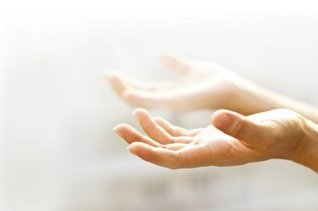
Pour the two words together from hand to hand. . .
until they become blended and balanced as one. . .

Slide 34
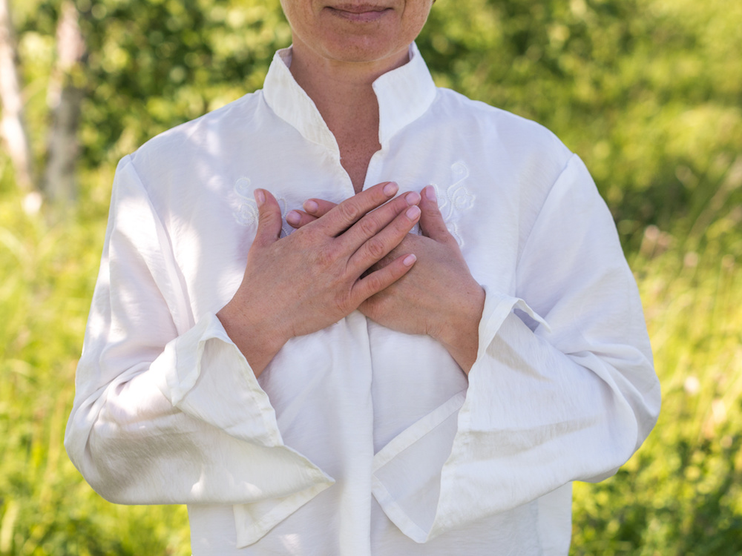
Bring that new energy home to your heart…

Slide 35
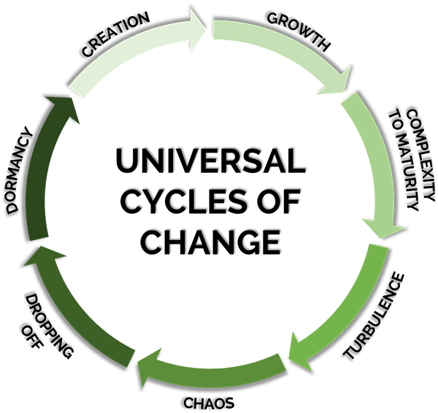
DESIGNED TO HELP US LEARN, GROW AND PROGRESS

Slide 36
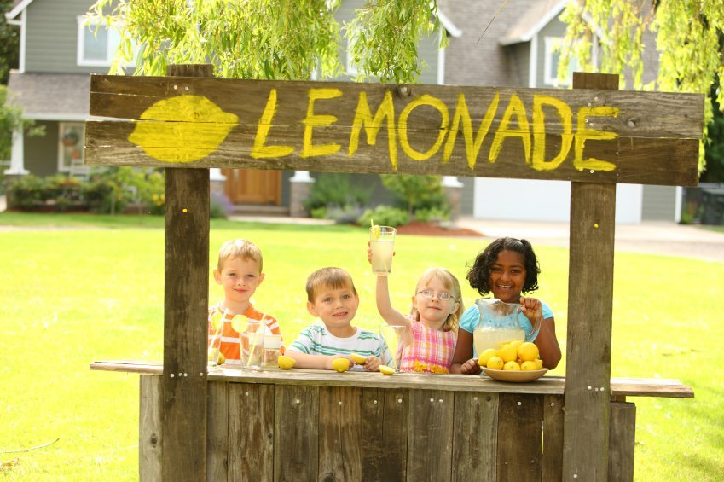
Life begins small in teaching us to turn our lemons into lemonade.

Slide 37
Not only in giving us lessons, but also in giving us grist for our mills.
MOST of our patterns and cycles begin with incidents, and what we made of them in childhood.
Usually, an “opening scene” or first memory can give powerful clues to patterns that repeat in our lives. Take time to journal your first memories and look for pertinent connections to current cycles of creation.

Slide 38
Every thought returns to the one who originated it.
Thoughts return multiplied by the images, actions and results of the cycle of creation.
It also accumulates the energies of others of similar thoughts, like iron filings to a magnet.

Slide 39
Innocence
is
one
thing. . .
Innocence
is the place you are before you learn, or before you’ve had a chance to catch up

Slide 40
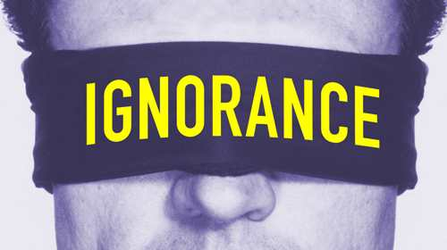
Is choosing to ignore
(also known as Denial)

Slide 41
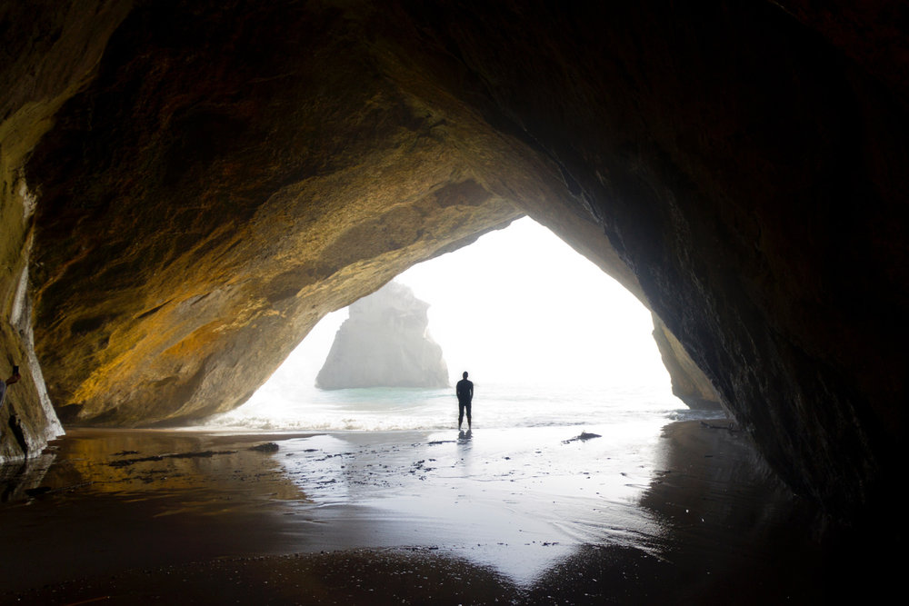
Real knowledge is to know the extent of one’s ignorance
Confucius

Slide 42
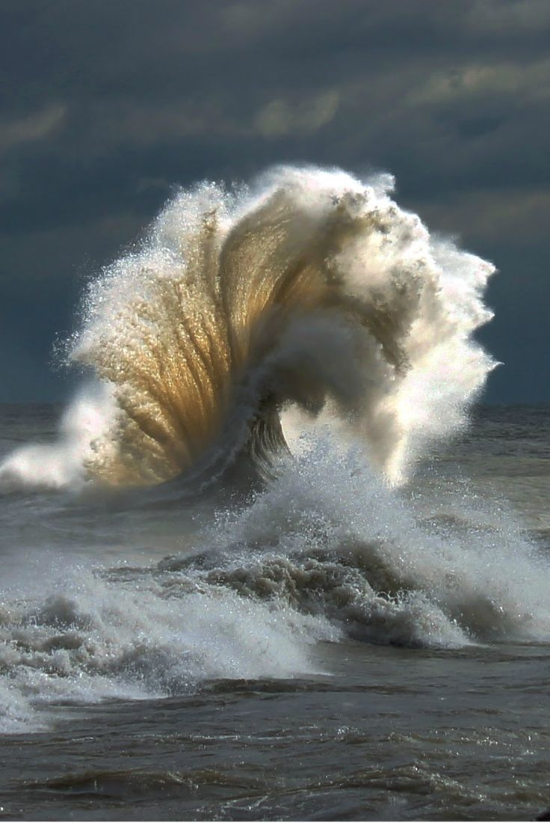
If you are still breathing, you have issues in your life that need to be addressed, and about which you are in denial.
You are in good company.
We are all in this boat together.

Slide 43
AND. . .
We can always choose again!
We can always work our way up the spiral of life toward the next, wider, more expanded level of awakening.

Slide 44
