Slide 1
Skills for Life
The Second Half of the Rapid Eye Model

Slide 2
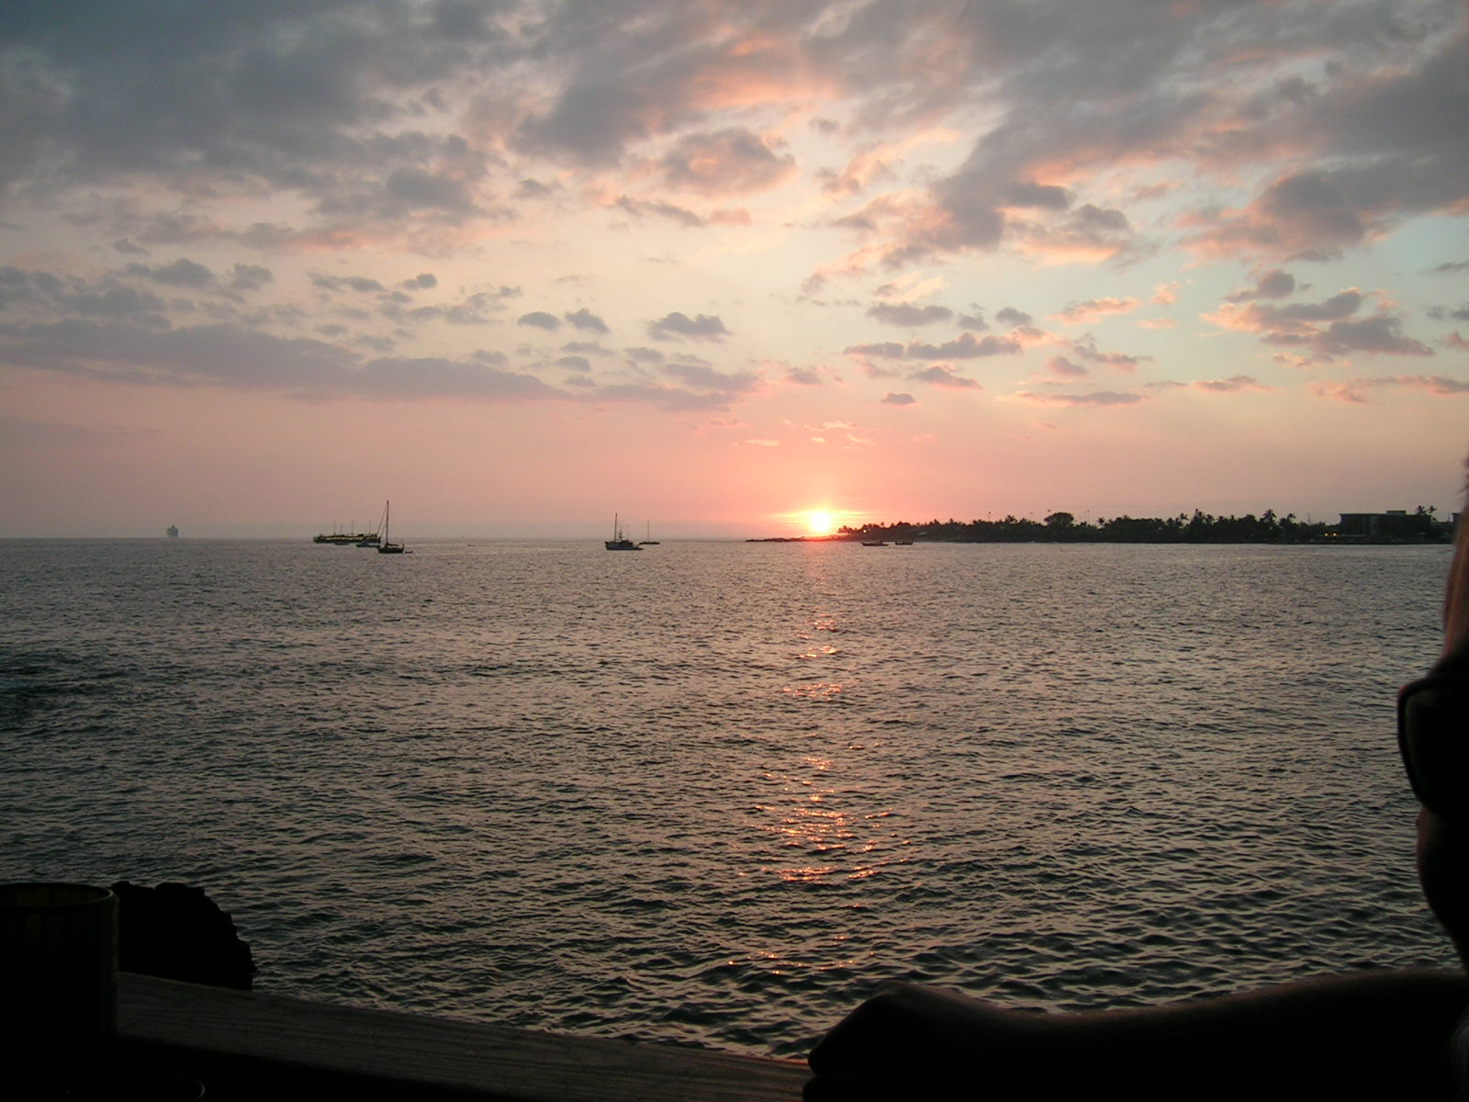
This presentation created by
Julia Fairchild
with loving Aloha!

Slide 3
The Principle of Perception
Your Perception is
Your Reality!

Slide 4
Energy is only energy -- until you place a perception on it. . .

Slide 5
Coupled with the perceptions
of another. . .

Slide 6
and upon what we are able to entertain as our possible reality What we perceive IS our REALITY
That which we ‘image-in’ is based on our predisposed conditioning, memories, assumptions, experiences,
beliefs,

Slide 7
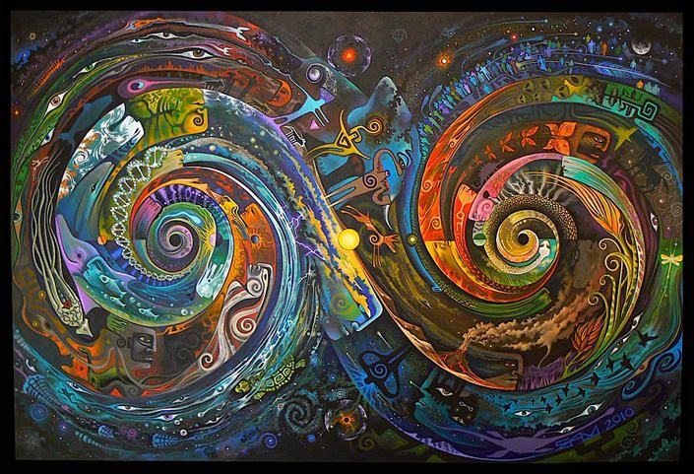
These perceptions weave the fabric of our life experience.

Slide 8
Until a perception we hold subconsciously is challenged, we may be unaware that it IS our perception –
it may ride along in our blind spot wholly undetected, until we unknowingly change lanes in its path…

Slide 9
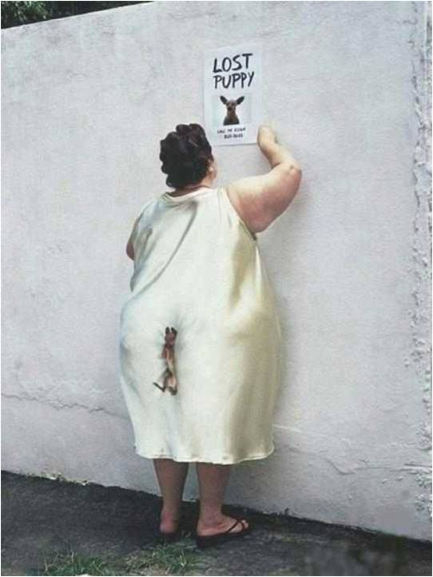
Perceptions of which we are unaware can cause pain in our lives…
Which is our first clue to look for the hidden messages, patterns, discords -- whatever causes us discomfort is a message to look for the misperception about what is REAL, and what we can do to bring our lives back into focus and balance.

Slide 10
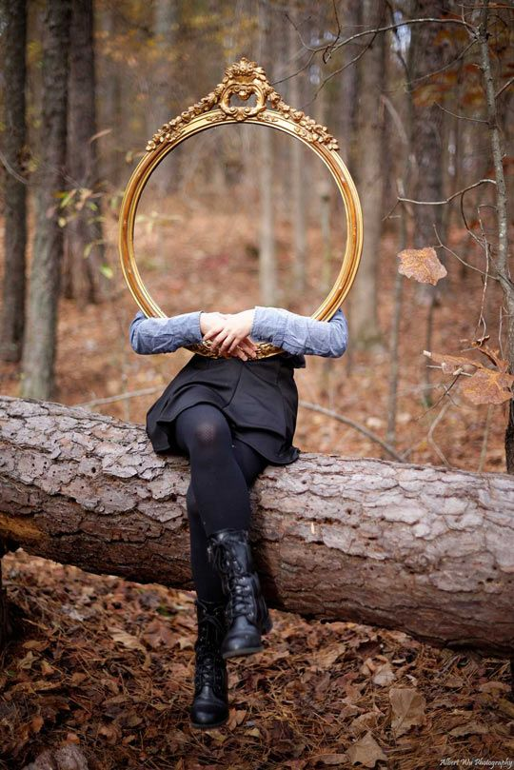
There are things known, and there are things unknown, and in between are the doors of perception.
Aldous Huxley

Slide 11
Your perception of me is a reflection of you.

Slide 13
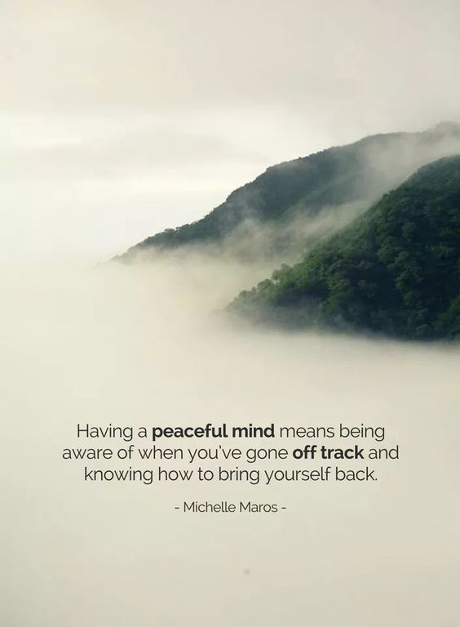

Slide 14
What do you see?
Coming? Or going?…
Notes:
It is said that if one sees ‘coming’ first, they are more optimistic, and ‘going’ first denotes pessimism as a first response. Being able to see both if helpful in understanding how easily our brains perceive that which we are unaware of.

Slide 15
Cynicism is a choice. . .
Optimism is a better choice!
Shondra Rimes

Slide 16
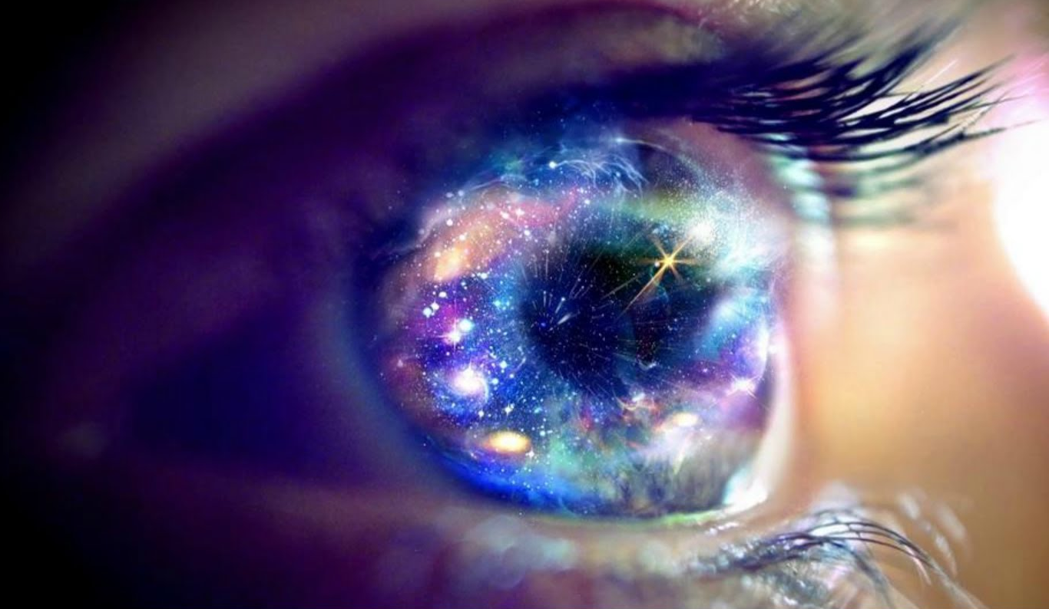
Optimism is the faith that leads to accomplishment.
Nothing can be
done without
hope and
confidence.
Helen Keller

Slide 17
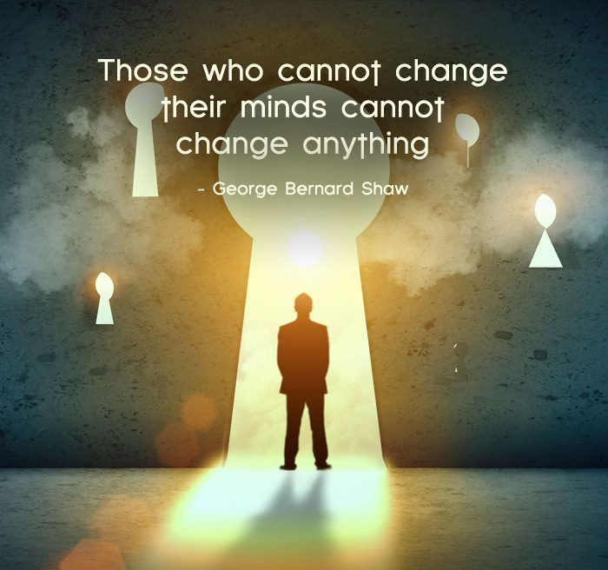

Slide 18
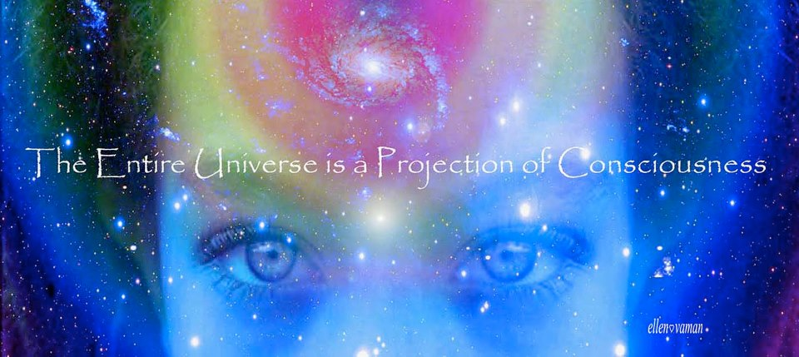
YOUniversal TRUTH!
The only thing wrong with you – is you think there’s something wrong with you ~ You don’t know who you are!

Slide 19
If the doors of perception were cleansed, everything would appear to man as it is. . . . . infinite
William Blake

Slide 20
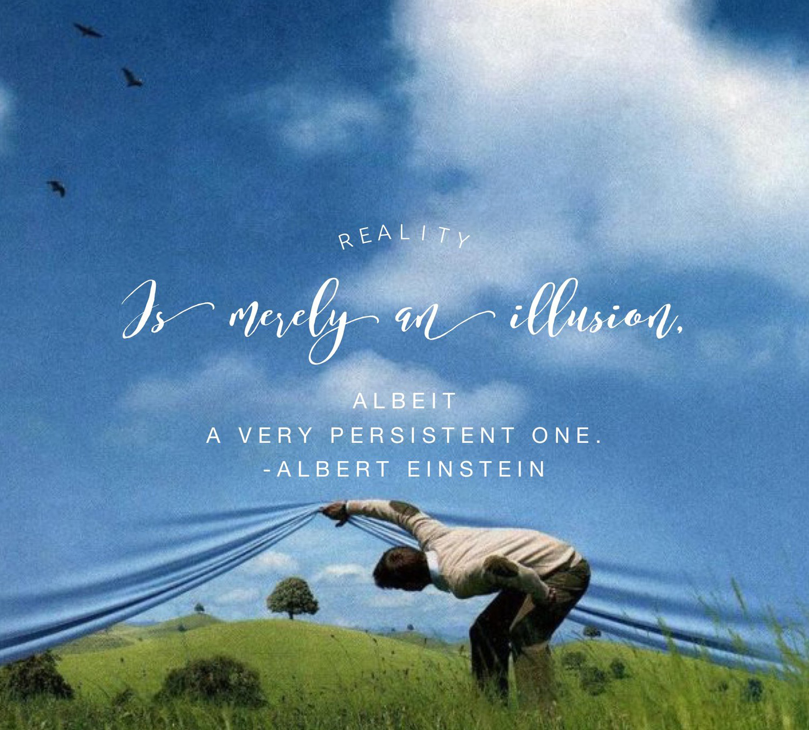
Reality is merely an illusion, albeit a very persistent one.
Albert Einstein

Slide 21
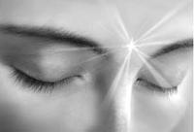
You cannot STOP doing anything
You must START doing something ELSE

Slide 22
Perspective can cause two people
to look at the same thing
and see two totally different things.

Slide 23
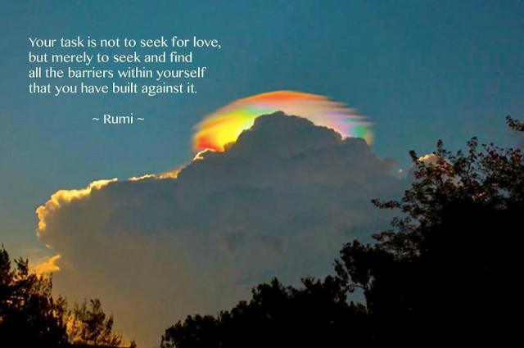
About Choosing:
This is a process designed to occupy and exercise your mind INSTEAD of worrying. The process should take you some time, and not be rushed or written down. The POINT is to memorize and hone your list

Slide 24
The primary cause of unhappiness is never the situation but your thoughts about it.
Eckhart Tolle

Slide 25
Your opinion is your opinion, your perception is your perception.
Do not confuse them with facts or truths
John Moore

Slide 26
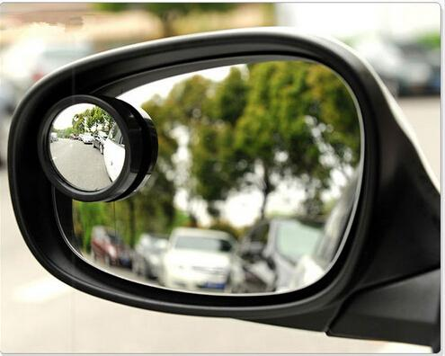
How does one discover their blind spots?

Slide 27
Look for uncomfortable patterns
in your life. . .

Slide 28
And continue on
your journey of self
discovery

Slide 29
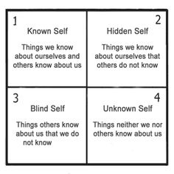
Take stock of those things you want to change and begin to figure out what you want instead.
ASK others to help you see your blind spots

Slide 30
Find ways that work for you to make a serious study of your own beliefs and perceptions that are steering you in paths you choose to change.
Journal
Find a Compassionate Witness
Try Peer Counseling
Seek out a Trusted advisor
Rapid Eye Technology

Slide 31
JOURNAL
All your answers lie within –- mine them!
Journals can save your LIFE! Writing can capture thoughts you didn’t know you had, and channel deep inner wisdom otherwise untapped. Spiritual Memory Is fleeting –Journals can preserve and protect precious insights and shed Light in the darkness

Slide 32
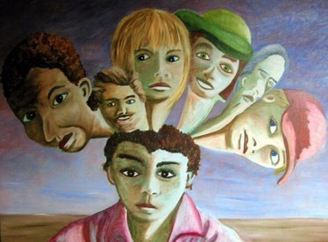
Inner Self Dialogue
We ALL have inner children, guides, guardians, judges, critics, and even ‘villains’ who rule our lives without our conscious awareness.
Gaining access to these inner ‘beings’ (states of being) and creating co-operation among them can go a very long way in allowing cohesion and integration within our lives – being able to live in integrity with our ideals without interference from inner conflicting subconscious characters in our makeup who mean well but who are operating without full awareness of the ‘facts’, of current ‘reality’, or of our best and highest good

Slide 33
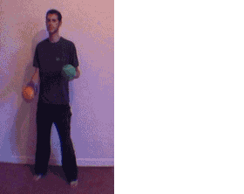
We each operate from two sides of the brain, which have very different roles:
Left brain – conscious, logical, bottom-line thinking which keeps us sane and operating on a day-to-day basis of logic and reason – roughly 10% of our brain power at our conscious disposal --
Right-brain sees the whole picture from beginning to end, operates in positive/spiritual mode, home to imagination, memory, artistic abilities, and in short, is the 90% of our brain which “uses us” according to our subconscious and superconscious filing systems, belief systems, perceptions, ancestral programs, etc.

Slide 34
Both sides of these stories can be accessed by a simple technique of writing which allows both hemispheres of the brain to participate in ongoing dialogue.
Simply switch the pen from one hand to the other, designating your dominant hand as the one asking the questions, and your opposite hand as the one who answers.
If there is any coaching, it is of dominant hand – helping to formulate questions – never allow anyone to suggest your answers! They will come from within.

Slide 35
If there are more than one voice speaking from the subconscious mind, one can simply change colors of ink to accommodate each participant.
It is possible to have a full array of inner voices attending a meeting conducted within the pages of your journal.

Slide 36
List the challenges and regrets that you have experienced in your life -- the ones you wish had been different, or those that have shaped your perspectives and perceptions. There is a process called the ‘BASK’ model
For each such experience, journal:
Behavior - What happened -- what were the circumstances? (Mental)
Affect - How did it make you feel? How do you still feel about it? (Emotional)
Sensation - Where did you feel that in your body - how has it affected your health? (Physical)
Knowledge - What were the gifts of this experience? How are you stronger or more capable or more compassionate as a result of this life path? (Spiritual)

Slide 37
Remember to include both sides of the brain, as well as conscious and subconscious (sometimes even super conscious) memories by using both hands to journal.

