Slide 1
Skills for Life
The Second Half of the Rapid Eye Model

Slide 2
This presentation created by Julia Fairchild with loving Aloha

Slide 3
The Principle of Health and Healing
“Wisdom is to the Soul what Health is to the Body”
Cesar Vichard de Saint-Rea

Slide 4
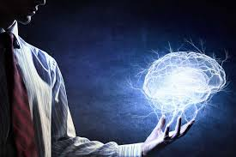
The mind directs the body We direct the mind

Slide 5
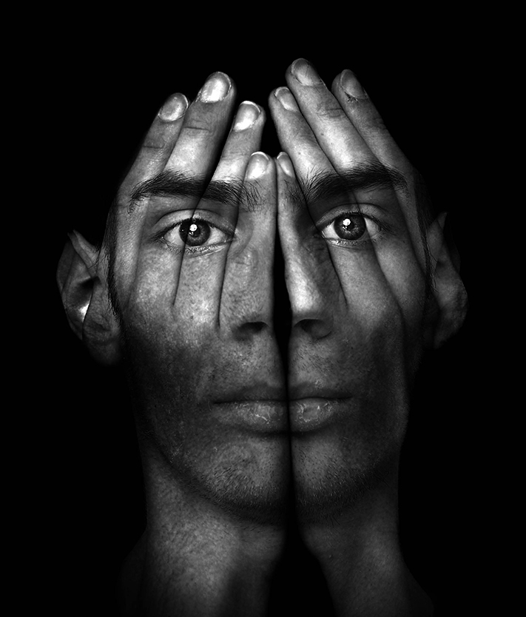
We live in an era where the mind-body connection is becoming universally accepted – both in scientific and ‘alternative’ circles.

Slide 6
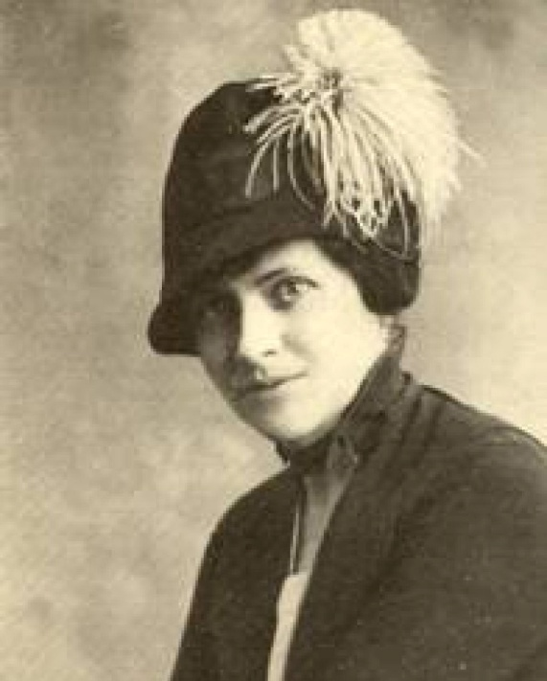
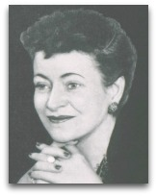
This is not a new idea. Helen Flanders-Dunbar, a pioneer in psychosomatic medicine, and dubbed ‘the mother of holistic medicine’, wrote in her book, Mind and Body:
“It is not a question of whether an illness is physical or emotional, but how much of each.”

Slide 7
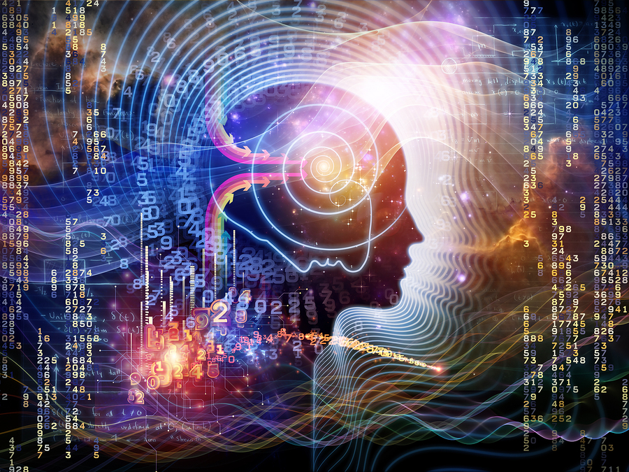
All illness has its primary origin in the mind, rather than in the body!

Slide 8
Pain – be it physical or emotional, results from an imbalance somewhere in your being.
It is evidence of some sort of toxin.
It may be toxic food, toxic emotions, or a toxic relationship.

Slide 9
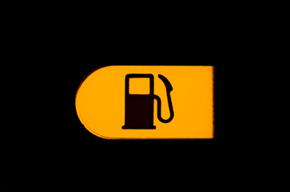
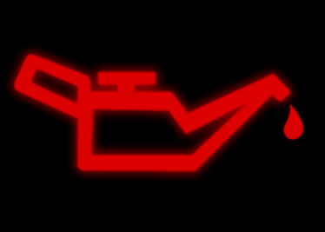
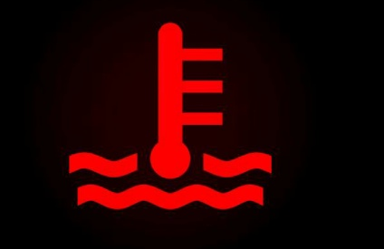
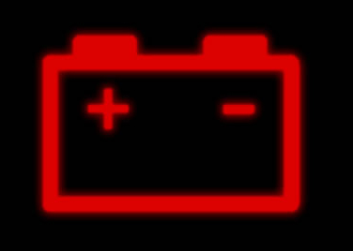
Pain serves a positive purpose
Without our indicator lights, we would be oblivious to the effects of maintenance needs to our vehicle.
Likewise, our corporal vehicle uses pain as indicators to let us know that something is amiss.
Ignoring them can leave you stranded on the side of the road.
Why are we more attentive to our dashboards than to our own hearts?

Slide 10
Emotional pain is experienced physically. Who among us has not experienced heartache?

Slide 11
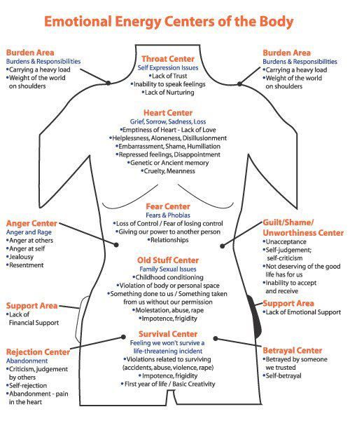
Physical and emotional pain is also the language of Spirit, guiding us along paths and drawing our attention to hidden issues that need to be addressed for our own best and highest good.

Slide 12
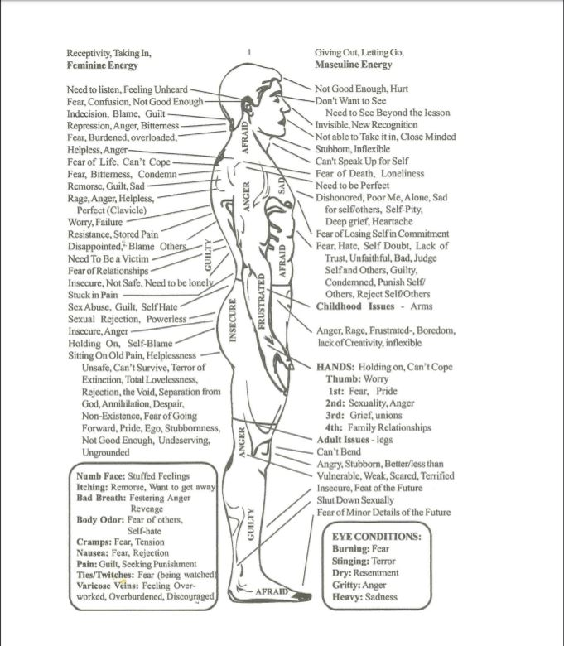
As every cell knows itself to be a skin cell, or a brain cell, or a blood cell, and behaves accordingly, every cell also has emotional intelligence.
Emotions are stored in areas of the body which relate to that emotion – the place from which that emotion is expressed.
Thus, the issues are in the tissues.

Slide 13
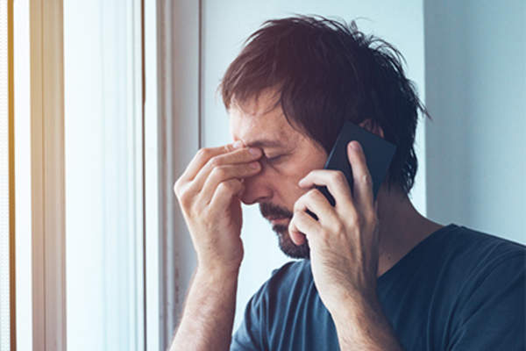
It may not feel that way, but this is really good news!
The body has built-in warning signals to keep us safe and well, and to encourage our spiritual growth.

Slide 14
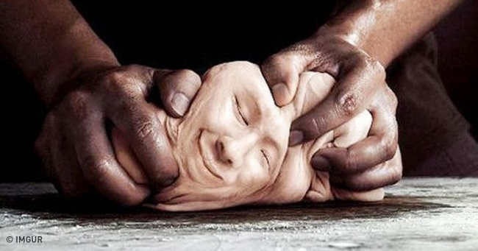
“Change happens when the pain of staying the same is greater than the pain of change.”
Tony Robbins

Slide 15
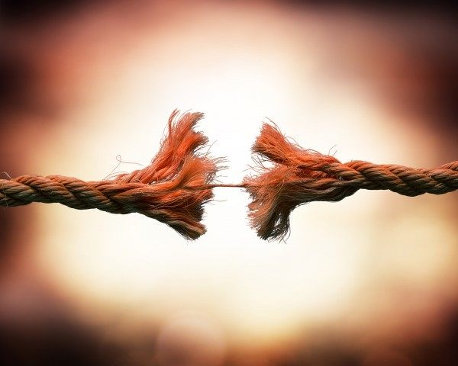
Dread
Hopeless
Cynical
Fear
Lonely
Regret
sad
Despair
Terror
Guilty
Jealousy
Bitterness
Toxic emotions create toxic chemicals in the body,
which affect the body accordingly.

Slide 16
FACTUALLY,
It is impossible to be fearful, anxious, irritated and healthy at the same time

Slide 17
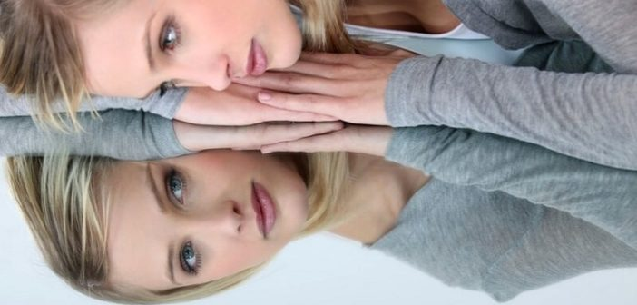
Your physical health is a reflection
of your mental health.

Slide 18
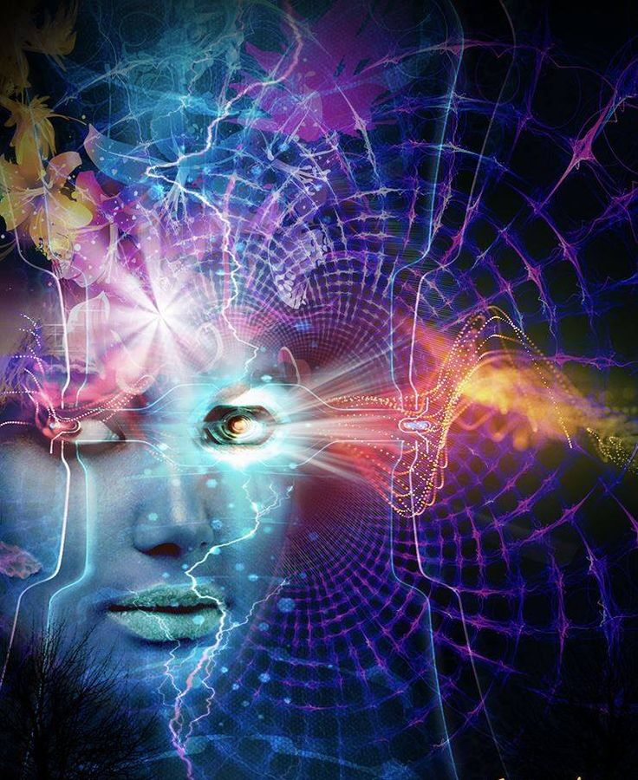
Our subconscious mind takes its direction from our system of beliefs,
oft-repeated self-talk, and other patterns that run in our minds, hearts, and families or origin.

Slide 19
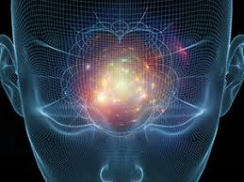
The power of the subconscious mind is many times more powerful than that of the conscious mind.
So leaving it on automatic pilot can be problematic if we haven’t weeded our mental and emotional gardens.

Slide 20
A FEW WORDS OF EXTREME
CAUTION!
NO HEALING JOURNEY
CAN BE ASSISTED BY
BLAME, SHAME, GUILT, OR JUDGMENT
OF YOURSELF
OR ANYONE ELSE!
Ever!

Slide 21
We have no idea, until we do the work, what plans our/their Higher Self has in store for our spiritual growth, or that of those we love, in creating our/their current seeming reality. Blaming ourselves or anyone else is only ever harmful.

Slide 22
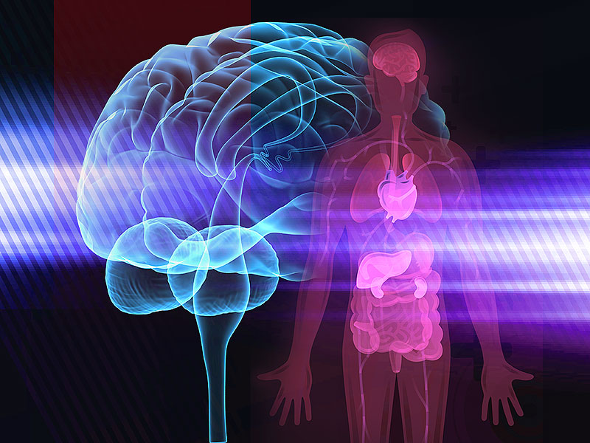
That said,
we are ultimately responsible
for our own health and well-being.
Our choices have brought us to the place we are.
Our choices can take us to a place we would rather be.
THAT is the definition of freedom.
We are not victim to our circumstances.

Slide 23
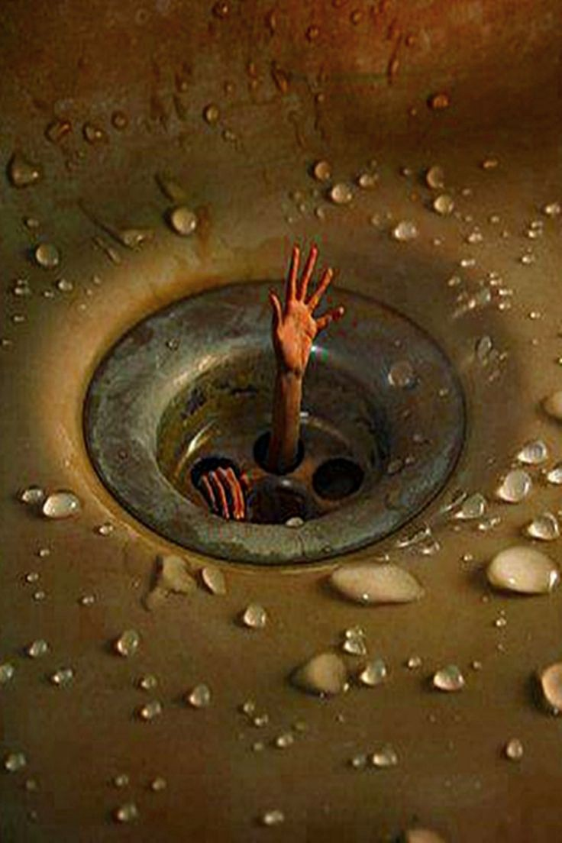
If we feel like we’re circling the drain, we need to find one hand or foothold to stop the downward spiral.
Hopefully,
we can put a stop in it before reaching
these depths.
BREATHE!

Slide 24
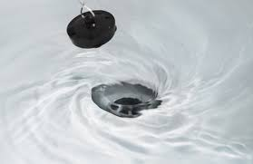
Having a stop prepared in advance will be helpful when the downward spiral begins.
By now we have learned effective tools to turn the tide of overwhelming circumstances, or to avoid getting there in the first place. . .
We ALL Deserve Great Abundance in our Lives

Slide 25
Thought
Choice
Perception
Cause
Accountability
Effect
Abundance
Gratitude
Health
Healing
The Life Skills Principles work together in harmony to achieve balance and progress

Slide 26
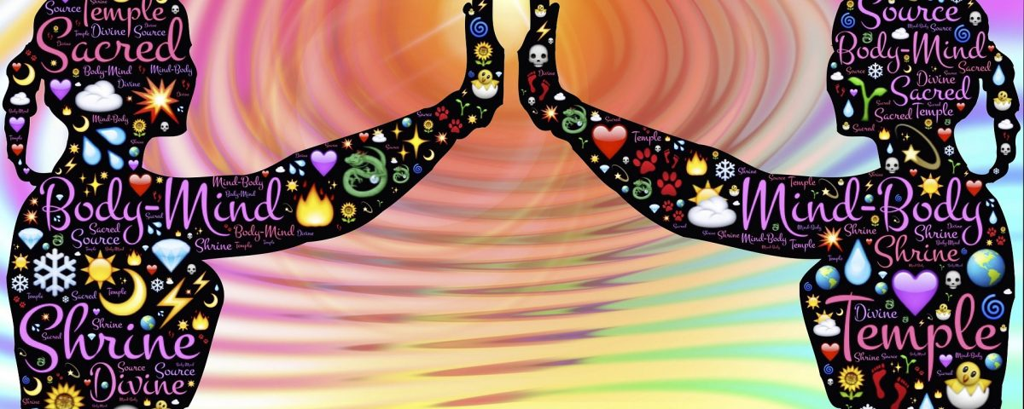
The principle of Health and Healing is where all of these tools and their application are put to the test.
Our physical health, circumstances and surroundings are the mirror of our reality, all SUBJECT, of course, to our life purpose and our self-directed means of achieving same.
For instance, Helen Keller’s life purpose probably required her condition to give thousands of people hope, encouragement, and example of success in spite of difficult circumstances.

Slide 27
Our entire being, body, mind and spirit act as a single unit.
It is a system of operations, each affecting the whole.

Slide 28
To heal any disease, whether mental, emotional or physical, go to the source of the condition and change the perception. By quiet meditation, journaling, and listening, the spirit can assist us in changing the perception creating the disease.

Slide 29
We heal ourselves by re-cognizing our own worth; we heal others by
re-cognizing the wholeness and divinity within them. When we perceive health in another, we heal ourselves.
We make health real in others by believing in their health.

Slide 30
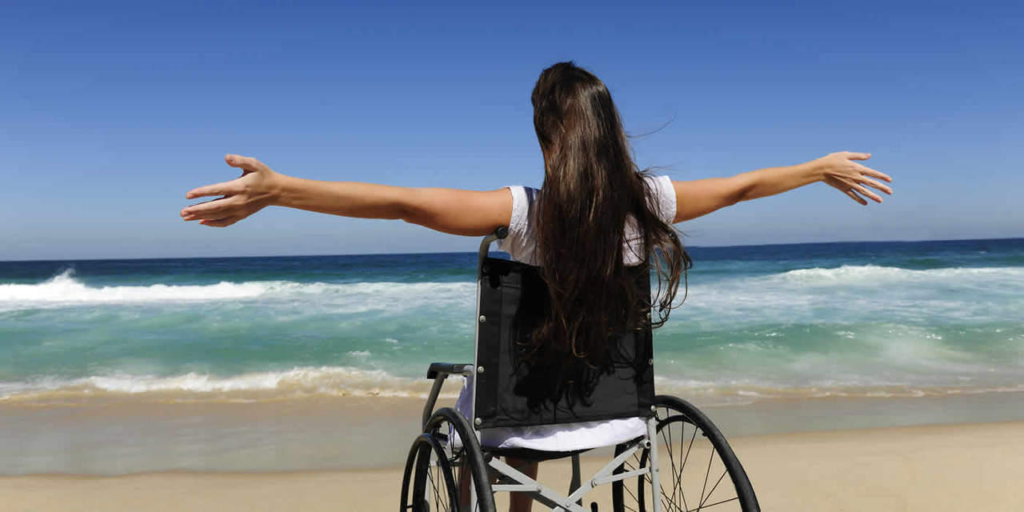
What may appear to us as illness or handicap may be another person’s (or our own) choice on a super-conscious level designed to bring a sought-after lesson, or to enable family members to grow in ways they need to grow, or to bring compassion and caring into a family line, or any number of reasons beyond our conscious ability to know.

Slide 31
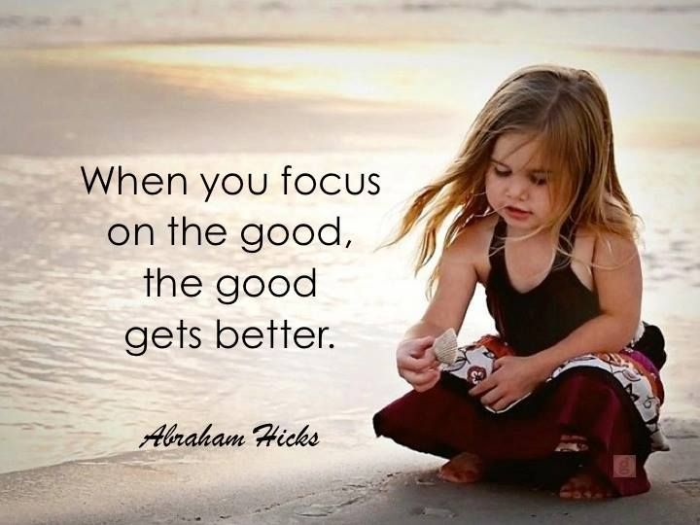

Slide 32
The ability to observe without evaluating is the highest form of intelligence.
Krishnamurti

Slide 33
Consider the possibility that the ‘Universe’ is a benevolent force, and
ALL
is in divine order

Slide 34
If that were true, how would your perspective change
on any given challenge?

